Slide 1
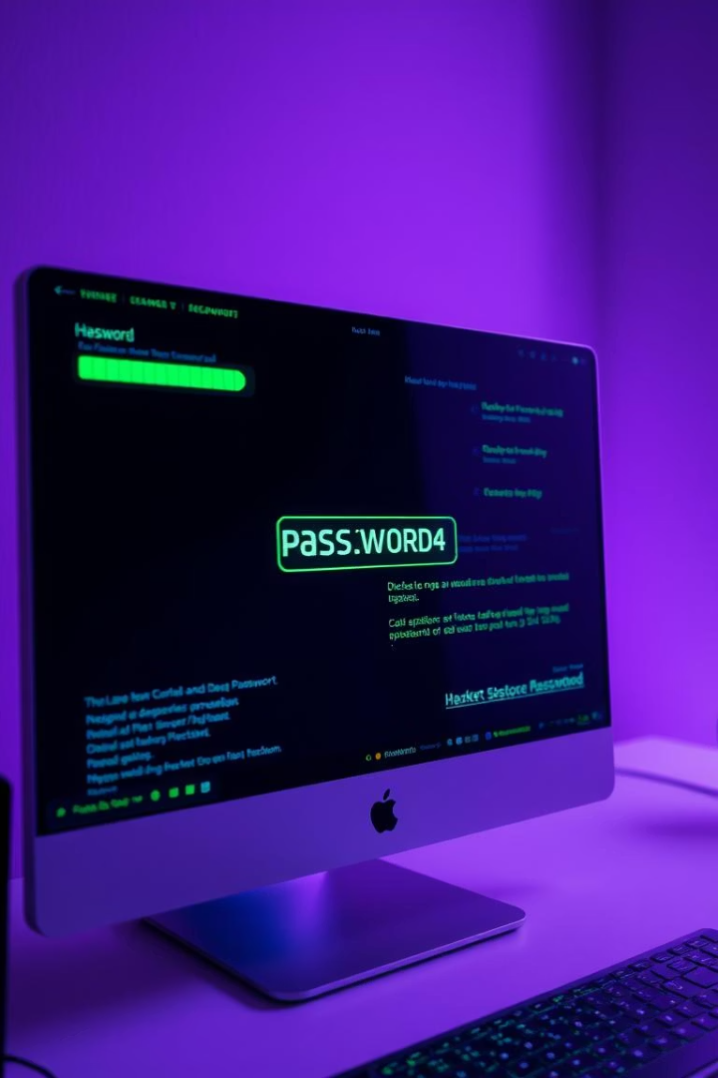
PASSO Checker: Hacker-Themed Password Strength Evaluator
A fun, Python-based tool with a Tkinter GUI that assesses password strength, checks for common passwords and dictionary words, and calculates entropy. It offers instant feedback and secure password suggestions through an engaging hacker-themed login simulation, educating users on robust cybersecurity practices.

Slide 2

Tool Features & Design
Interactive GUI
Strength Evaluation
Password Suggestions
Hacker-themed login simulation with real-time feedback.
Uses entropy, character diversity, length, and dictionary checks.
Generates strong passwords with mixed characters and length.

Slide 3

Problem & Objective
Problem
Objective
Goal
Weak passwords expose users to cyberattacks and data breaches.
Create an intuitive tool that educates and improves password security.
Provide instant feedback and actionable suggestions via a user-friendly GUI.

Slide 4
Literature & Standards
NIST & OWASP
Zxcvbn
Academic Research
Recommend long, diverse passwords and avoiding common words.
Entropy-based strength estimator inspiring PASSO Checker's calculations.
Highlights usability-security tradeoffs and need for user-friendly tools.

Slide 5
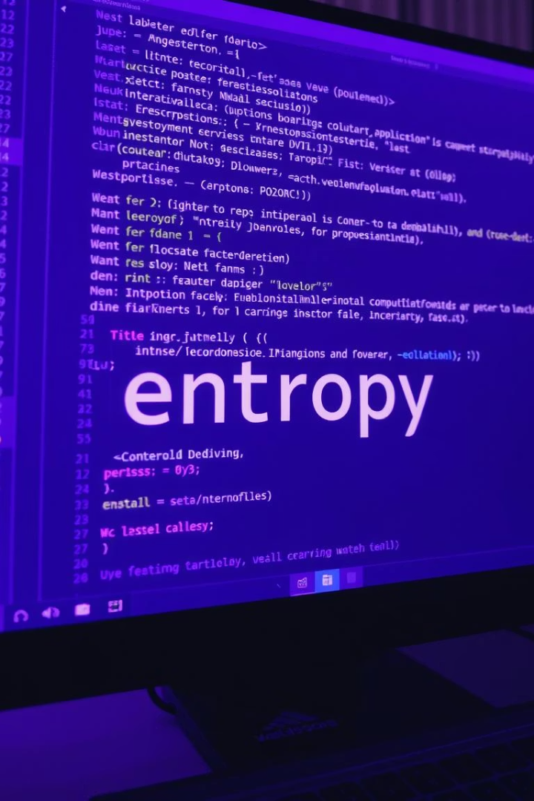




Research Methodology
Python & Libraries
Uses re, tkinter, math, and random modules.
Entropy Calculation
Calculates entropy as length × log2(character set size).
Rule-Based Checks
Validates length, character types, common passwords, and dictionary words.
GUI Features
Strength indicators, toggle button, and detailed feedback.

Slide 6
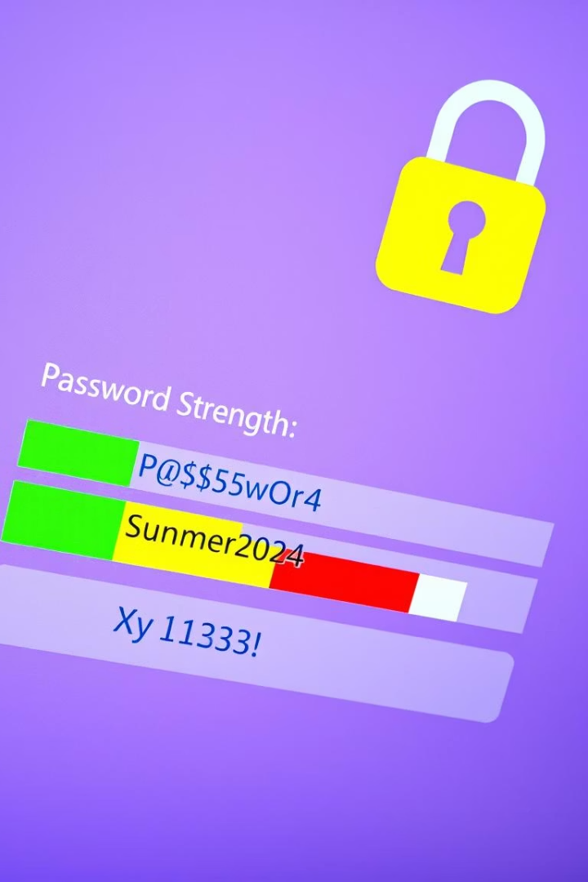
Results & Observations
Testing
Tested 30 passwords; 20 failed criteria like missing special chars.
Feedback
Messages like "Weak: Add special character" guide users.
Strong Passwords
Suggested passwords scored above 60 bits entropy consistently.
User Engagement
Visual feedback and hacker messages increased awareness.

Slide 7

Ethical Impact & Market Relevance
Education
Integration
Promotes cybersecurity awareness with clear feedback and resources.
Can be embedded in web forms, registration systems, or browser plugins.
Versatility
Useful for individuals and organizations to improve security.

Slide 8
Future Scope
Multilingual Support
GUI Enhancements
Web Integration
Advanced Checks
Include Unicode and non-English characters for complexity.
Add dynamic strength meters and progress bars.
Develop JavaScript version or API for online use.
Connect to breach databases and enforce corporate policies.

